Slide 1

WHAT THE **** IS A DATA PRODUCT?

Slide 2



Johnny winter (HE/HIM)
Notes:
I’m Johnny Winter – my pronouns are he him.
For those that don’t know me…
I work as a consultant for Advancing Analytics – we’re Data Engineering, Analytics and AI specialists
In my spare time I run the website Greyskull Analytics where I have a blog and YouTube channel, mainly covering content on Power BI
And I’m also one of the co-organisers of the Manchester Power BI user group, one of the biggest and longest running user groups in the UK

Slide 3






Notes:
I’ve been working in data since 2007 and here are some of the places that career has taken me.
My last 3 roles have all been consultancy jobs

Slide 4
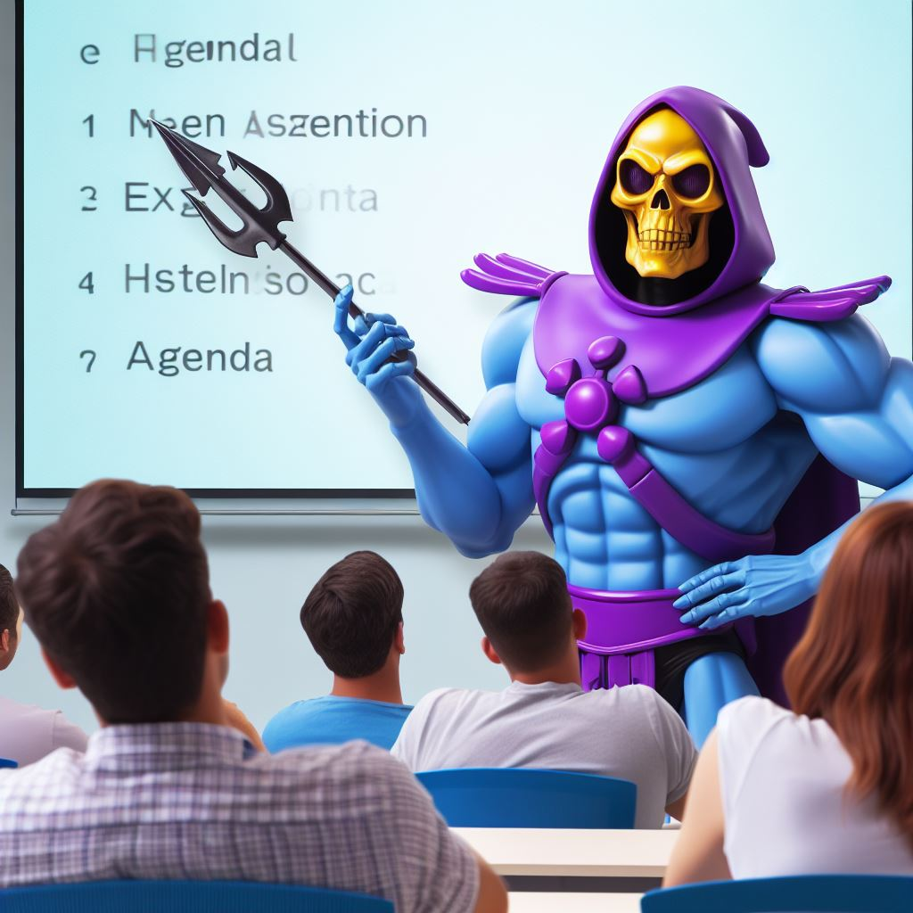
agenda
Where did the term come from?
What does it mean?
Is it a good idea?

Slide 5
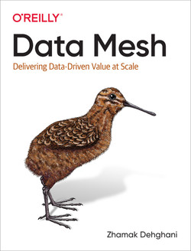

The RISE OF DATA PRODUCTS
Notes:
Published in 2022

Slide 6




THE 4 PRINCIPLES OF DATA MESH
Principle of Domain Ownership
Principle of Data as a Product
Principle of the Self-Serve Data Platform
Principle of Federated Computational Governance

Slide 7

WORKING PRACTICE CHANGES
Code first based approaches (Spark, Scala, Python)
Infrastructure as Code (Terraform, Bicep)
Better source control practices
Continuous Integration / Continuous Deployment (CI/CD)
Testing
Automation
Notes:
With changes in technology, we’re also seen working practices evolve, borrowing practices from software engineering.

Slide 8

“They’ve re-badged it, you fool!”

Slide 9
Questions?

Slide 10
THANK YOU!
Twitter:
@GreyskullPBI
LinkedIn: https://www.linkedin.com/in/j0hnnyw1nter/
Websites:
https://greyskullanalytics.com/
https://www.advancinganalytics.co.uk/

